Slide 1

PROJECT TITLE
Software Requirement Specifications (SRS)
Version 1.0
B.Tech.(ECS 591)
Degree
BACHELOR OF TECHNOLOGY (CSE)
PROJECT GUIDE:
SUBMITTED BY:
Miss. LUCKY RAJPUT SANGEETA KUMARI MAHATO(TCA1509083)
September 2017
COLLEGE OF COMPUTING SCIENCES AND INFORMATION TECHNOLOGY TEERTHANKER MAHAVEER UNIVERSITY, MORADABAD

Slide 2
TMU-CCSIT
Version 1.0
T006-Project Requirements
 | Date | Reason For Changes | Version
<Project Team Code> | DD-MM-YY | initial draft | 1.0 draft 1
<Project Team Code> | DD-MM-YY | baseline following changes after inspection | 1.0 approved
Revision History
Approved by: Project Guide Name:Miss.LUCKY RAJPUT
Signature:
Project Title:
Page 2 of 15

Slide 3
TMU-CCSIT
Version 1.0
T006-Project Requirements
Table of Contents
> INTRODUCTION..............................................................................................................................................4
> SCOPE OF THE WORK........................................................................................................................................4
> DEFINITIONS, ACRONYMS, AND ABBREVIATIONS..............................................................................................4
> REFERENCES.....................................................................................................................................................4
> BOOKS...............................................................................................................................................................4
> OVERALL DESCRIPTION.............................................................................................................................6
> PRODUCT PERSPECTIVE.....................................................................................................................................6
> PRODUCT FUNCTIONS........................................................................................................................................6
> U SER CHARACTERISTICS...................................................................................................................................6
> ASSUMPTIONS AND DEPENDENCIES...................................................................................................................7
> SPECIFIC REQUIREMENTS.........................................................................................................................7
Appendix A: Data Flow Diagram (DFD)
Appendix B: Entity-Relationship Diagram (ERD)
Appendix C: Use-Case Diagram (UCD)
Appendix D: Data Dictionary (DD)
Appendix E: Screen Shots
Project Title:
Page 3 of 15

Slide 4
TMU-CCSIT
Version 1.0
T006-Project Requirements
Introduction
Library Management System is an application which refers to library systems which are generally small or medium in size. It is used by librarian to manage the library using a computerized system where he/she can record various transactions like issue of books, return of books, addition of new books, addition of new students etc. Books and student maintenance modules are also included in this system which would keep track of the students using the library and also a detailed description about the books a library contains.
Scope of the Work
All the manual work should we converted into computerized so that the load of admin is decrease. The data base should be store stored in computer rather than in register/manuals.
A central portal to enjoy the advantage of library management system. Admin can keep the records of all books from our system in easiest way.
Library Management System is basically updating the manual library system into an internet-based application so that the users can know the details of their accounts, availability of books and maximum limit for borrowing.
> Definitions, Acronyms, and Abbreviations
JAVA -> platform independence SQL-> Structured query Language ER-> Entity Relationship UML -> Unified Modeling Language IDE-> Integrated Development Environment SRS-> Software Requirement Specification ISBN -> International Standard Book Number IEEE ->Institute of Electrical and Electronics Engineers
References
Some java Books
• Software Requirements and Specifications: A Lexicon of Practice, Principles and Prejudices (ACM Press) by Michael Jackson
Project Title:
Page 4 of 15

Slide 5
TMU-CCSIT
Version 1.0
T006-Project Requirements
• Software Requirements (Microsoft) Second EditionBy Karl E. Wiegers
• Software Engineering: A Practitioner's Approach Fifth Edition By Roger S. Pressman
> Websites
http://www.slideshare.net/
http://ebookilv.net/doc/srs-librarv-management-svstem/
Project Title:
Page 5 of 15

Slide 6
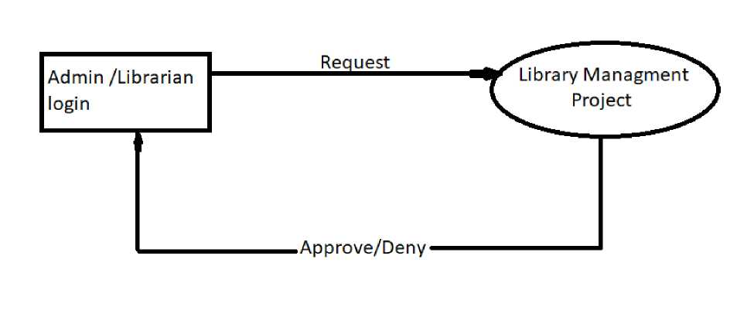
TMU-CCSIT
Version 1.0
T006-Project Requirements
> Overall Description
> Product Perspective
This is a broad level diagram of the project showing a basic overview. The users can be either staff or student.. This System will provide a search functionality to facilitate the search of resources. This search will be based on various categories viz. book name or the ISBN. Further the library staff personnel can add/update the resources and the resource users from the system.The users of the system can request issue/renew/return of books for which they would have to follow certain criteria.
> Product Functions
The Online Library System provides online real time information about the books available in the Library and the user information. The main purpose of this project is to reduce the manual work. This software is capable of managing Book Issues, Returns, Calculating/Managing Fine, Generating various Reports for Record-Keeping according to end user requirements. The Librarian will act as the administrator to control members and manage books. The member's status of issue/return is maintained in the library database. The member's details can be fetched by the librarian from the database as and when required. The valid members are also allowed to view their account information.
> User Characteristics
The system provides different types of services based on the type of users [Member/Librarian]. The Librarian will be acting as the controller and he will have all the privileges of an administrator.
The features that are available to the Librarian are:-
-i A librarian can issue a book to the member.
-i Can view the different categories of books available in the Library
Project Title:
Page 6 of 15

Slide 7
TMU-CCSIT
Version 1.0
T006-Project Requirements
-i Can view the List of books available in each category -i Can take the book returned from students
— Add books and their information to the database
— Can check the report of the existing books
— Can check the report of the issued books
— Can access all the accounts of the students
The features that are available to the Members are:— Can view the different categories of books available in the Library
— Can view the List of books available in each category
— Can own an account in the library.
— Can view the books issued to him
— Can put a request for a new book
— Can view the history of books issued to him previously
— Can search for a particular book
> Assumptions and Dependencies
The assumptions are:
— — The coding should be error free
— The system should be user-friendly so that it is easy to use for the users
— The information of all users, books and libraries must be stored in a database that is accessible by the website
— The system should have more storage capacity and provide fast access to the database
— The system should provide search facility and support quick transactions
— The Library System is running 24 hours a day
— Users may access from any computer that has Internet surfing capabilities.
> Specific Requirements
Software Configuration: -
Project Title:
Page 7 of 15

Slide 8
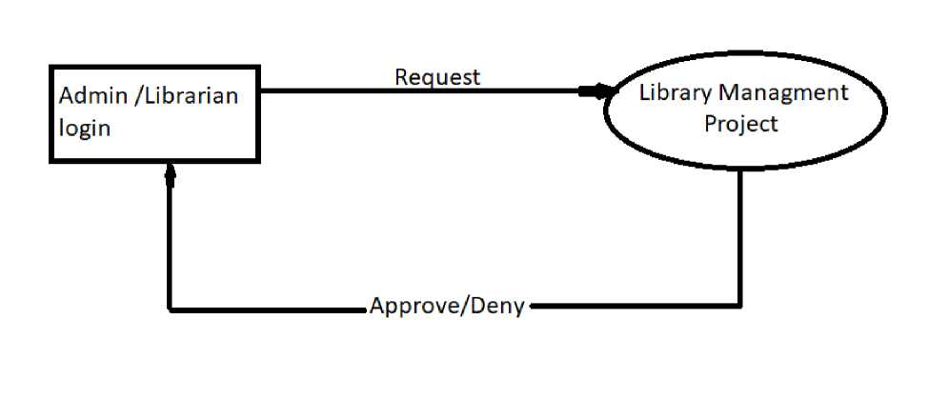
TMU-CCSIT
Version 1.0
T006-Project Requirements
This software platform is developed spending java as front end which is held by sun micro system. Microsoft SQL Server as the back end to store the database.
Operating System:
Windows NT, windows 98, Windows XP
Language: Java Runtime Environment, Eclipse 7.0.1 (front end)
Database: MS SQL Server (back end)
Hardware Configuration: -Processor: Pentium(R)Dual-core CPU Hard Disk: 40GB RAM: 256 MB or more
Appendix A
Data Flow Diagram (DFD)
(Mandatory)
Project Title:
Page 8 of 15

Slide 9
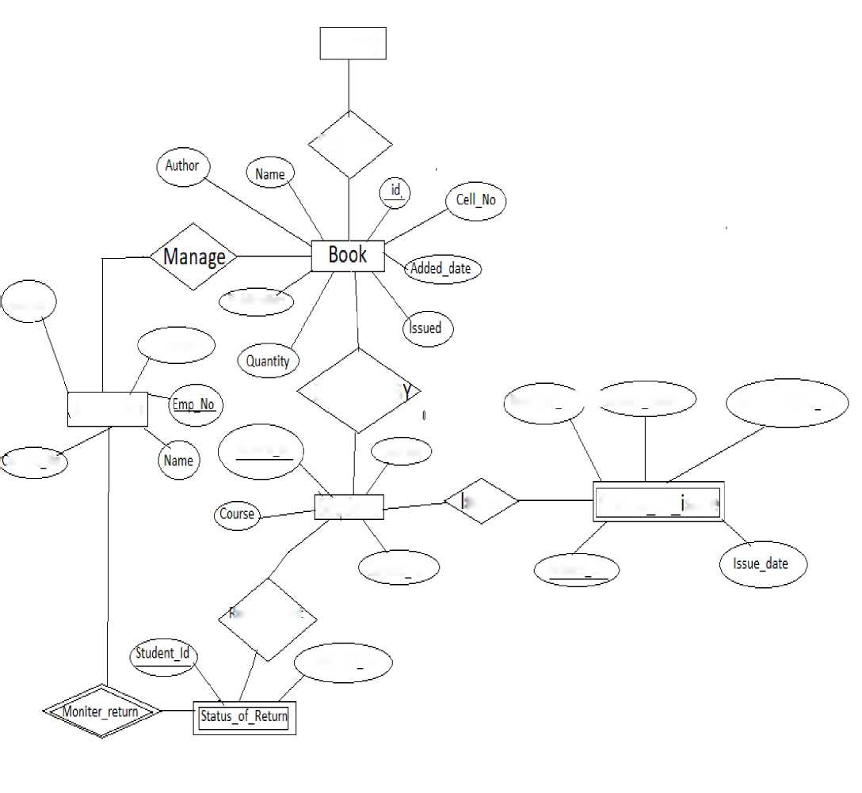
TMU-CCSIT
Version 1.0
T006-Project Requirements
Appendix B
Entity-Relationship Diagram (ERD)
(Mandatory)
Library
Contain
Address
Publication
Password
Librarian
Borrowed B
Book cell no^i (Student Name
Student contact no
ontact No
Student Id
Address
Student
ssue
Status
of
ssue
Contact no
Student Id
letum request
Book cell no
Project Title:
Page 9 of 15

Slide 10
TMU-CCSIT
Version 1.0
T006-Project Requirements
Appendix C Use-Case Diagram (UCD)
(Optional)
Project Title:
Page 10 of 15

Slide 11
TMU-CCSIT
Version 1.0
T006-Project Requirements
Appendix D Data Dictionary (DD)
(Mandatory)
Example:
Admin Table
Fields | Data type | Description
Admin-Name | Text | Admin Id
Admin-Password | Text | Admin password
Librarian Table
Fields | Data type | Description
Name | Text | Librarian Name
Password | Text | Librarian Password
Emp_No | Number | Librarian Id
Address | Text | Librarian Address
Contact No. | Number | Librarian mobile No.
Book Table
Fields | Data type | Description
Id | Alphanumeric | Book Id
Cell No. | Number | Book cell Number
Name | Text | Book Name
Author | Text | Book Author Name
Publication | Text | Book Publication
Quantity | Number | Quantity of Books
Issued | Number | Number of book issues
Added_date | Date | which date added of book
Project Title:
Page 11 of 15

Slide 12
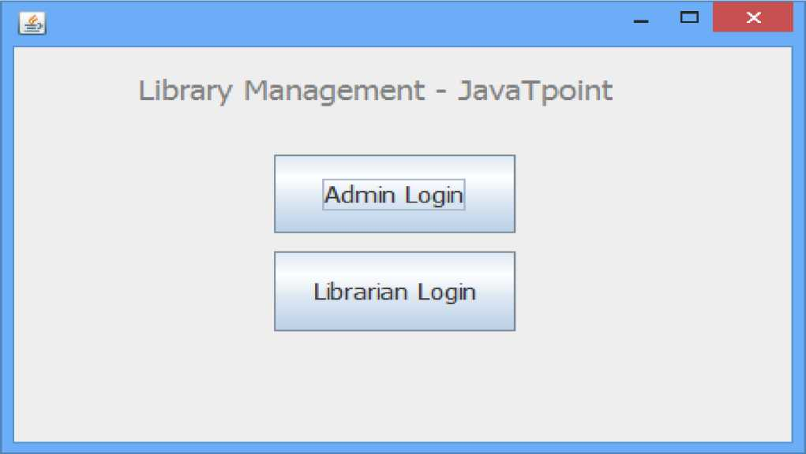
TMU-CCSIT
Version 1.0
T006-Project Requirements
Issued Book:-
Fields | Data type | Description
Book Cell_No. | Number | Book Cell Number
Student_Id | Number | Student Enrollment Id
Stdent _Name | Text | Student Name
Student_Contact | Number | Number
Issue_Date | Date | Issued Date of Book
Appendix E Screen Shots
<Guidelines: Show all Pages>
Login Form:
Project Title:
Page 12 of 15

Slide 13
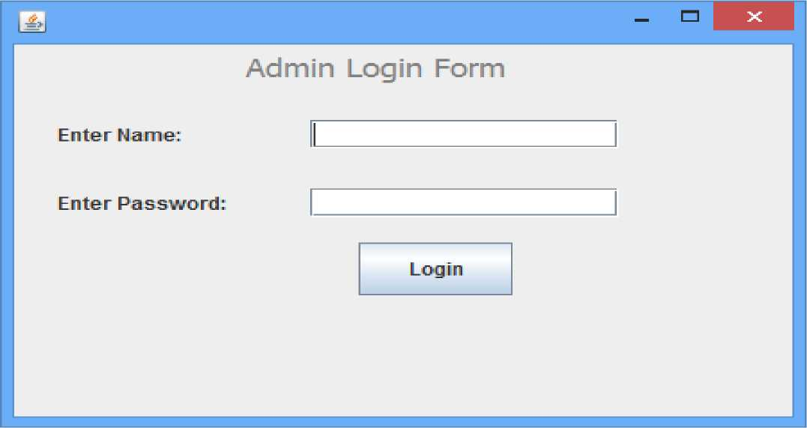
TMU-CCSIT
Version 1.0
T006-Project Requirements
Admin Login Form:
Project Title:
Page 13 of 15

Slide 14
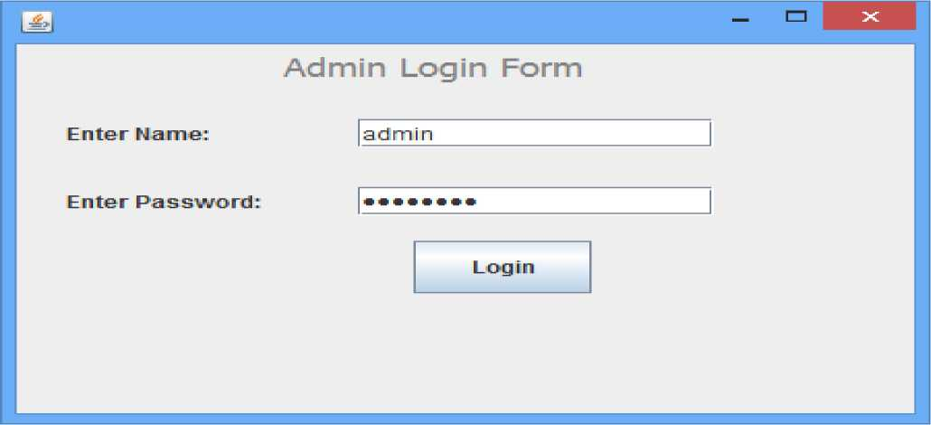
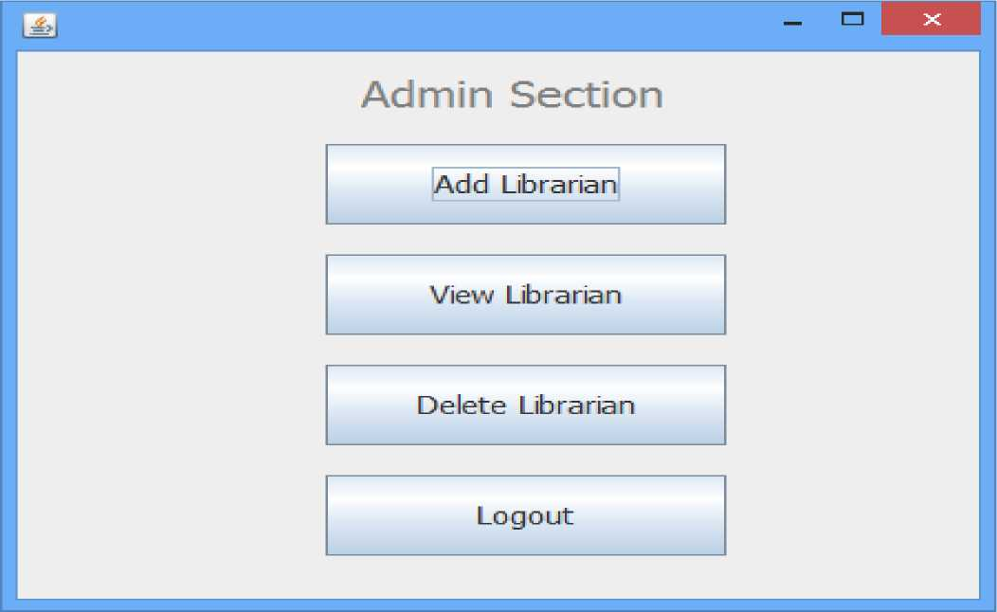
TMU-CCSIT
Version 1.0
T006-Project Requirements
Project Title:
Page 14 of 15

Slide 15
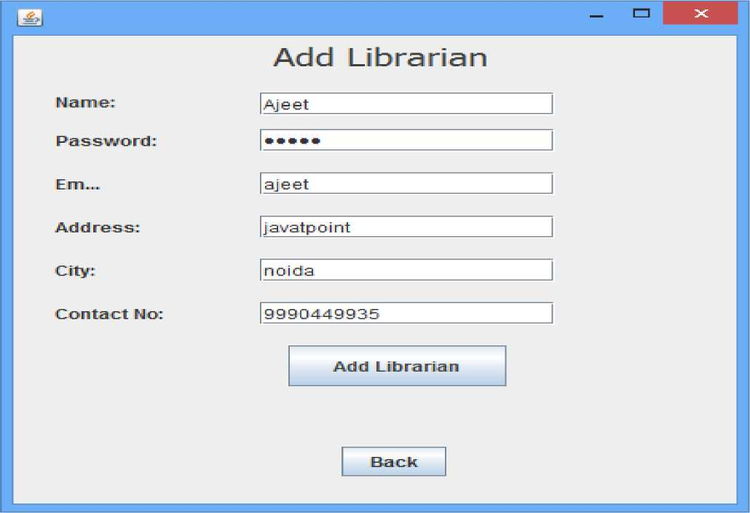
TMU-CCSIT
Version 1.0
T006-Project Requirements
Project Title:
Page 15 of 15

